Slide 1
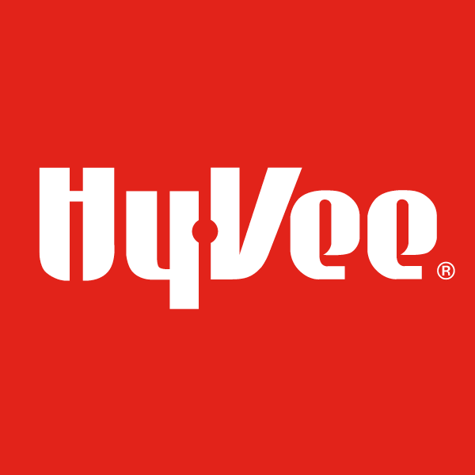
HyVee Liquor Store Analysis
Capstone Project by Aniruddha Dhar

Slide 2
Table of contents
01
02
03
About the project
EDA
Store Segmentation
04
05
06
MBA
Sales Forecasting
Conclusion
Data source, Features, Preprocessing, Cleansing
Exploratory data analysis and visualization
Categorize to identify high-value stores
Market basket analysis to identify shopping patterns
Time series analysis and sales forecast
Concluding thoughts and future work

Slide 3
01
About the project
Data source, Features, Preprocessing, Cleansing

Slide 4
The Dataset
The dataset contains information on liquor sales made by Class “E” liquor licensees in the state of Iowa and published by Department of Commerce, Alcoholic Beverages Division
Class “E” licensees refer to stores that sell alcohol in bottled form for off-the-premises consumption
Period: January 1, 2012 – Present
Provides information on stores, products, pricing, sales quantity, sales volume and the transaction amount
Over 19M records, 24 features, ~ 300 vendors, ~ 2400 stores, 9400 liquor products

Slide 5

What are we working on
We will restrict our analysis to sales achieved by HyVee retail stores in Iowa
The employee-owned Hy-Vee chain is headquartered in Illinois, Iowa and operates retail outlets in locations around mid-western US
Over 265 grocery stores and drugstores
Category: Food and Personal Care, Pharmacy
Revenue: $10.1B (as of December, 2019)
Employees: 85,000

Slide 6
What is the research plan
Perform initial data cleaning to handle inconsistency
Perform data modelling and load HyVee specific records to SQLite database
Store segmentation analysis to determine the most valuable stores in the state
Market basket analysis for the most valuable store
Sales forecasting with time series analysis

Slide 7
Our Datastore
Product ProductID
Iowa Liquor
Sales
Database
Price ProductID
Sales ProductID
Vendor VendorID
Store StoreID
Transactions TransactionID

Slide 8
Data Cleaning
Same category/item number associated with multiple category names/item description
Inconsistency with bottle volume associated with an item
Vendor ID mapped to non-unique names
Same store associated with non-unique location coordinates and store names
Price variation for StateBottleRetail and StateBottleCost across days
Duplicate records in table

Slide 9
02
Exploratory Data Analysis
Exploratory data analysis and visualization

Slide 10
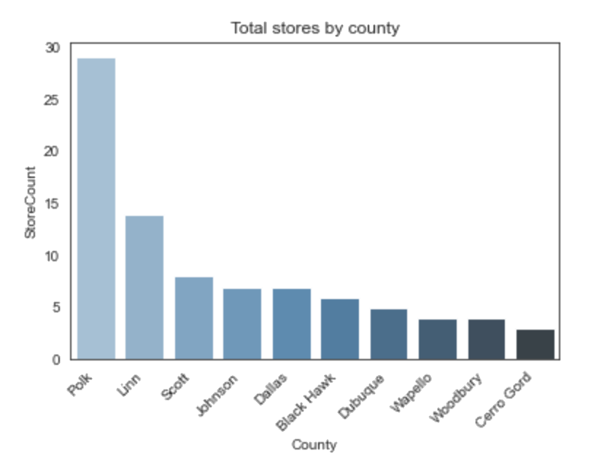
Store Distribution Store locations across the state
Polk county has the maximum number of stores to support its large population. The store count in general shows an upward trajectory with increasing population

Slide 11
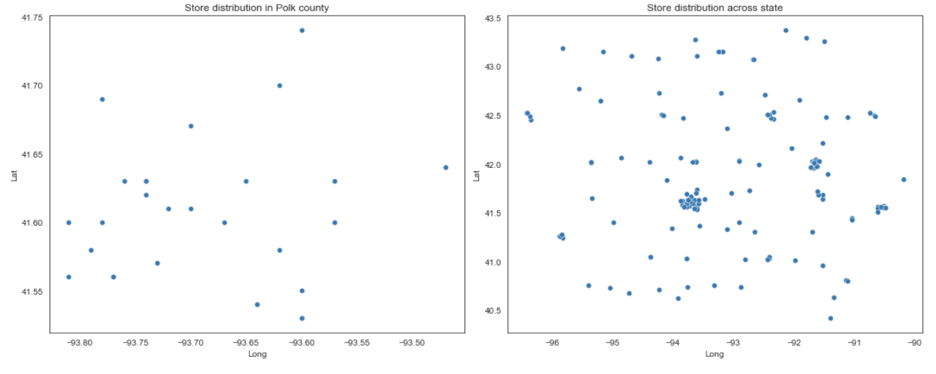
Store Distribution Store locations across the state
State-wise distribution shows clusters with high density of stores. Looking at Polk county, we see that in spite of the high number of stores, they are fairly dispersed

Slide 12
Store Lifecycle How long do stores remain operational
Lifecycle of stores in counties like Polk and Dallas which have high number of stores is low
Similarly, outlets in counties with high number of stores per capita have relatively lower lifespan (Clarke, Appanoose)

Slide 13
Store Lifecycle How long do stores remain operational
Stores categorized based on keywords in Store Name
Mean operational lifespan relatively low for General Stores (5 years) compared to the average for all HyVee stores (10 years)

Slide 14
Store Expansion Growth in number of stores over time
Number of HyVee stores in Iowa increased significantly during 2019-20

Slide 15
Store Expansion Growth in number of stores over time
Most of the growth can be attributed to the expansion in Polk county during this period

Slide 16
Store Expansion Growth in number of stores over time
Also, growth during 2019-20 accelerated by opening of new General Stores

Slide 17
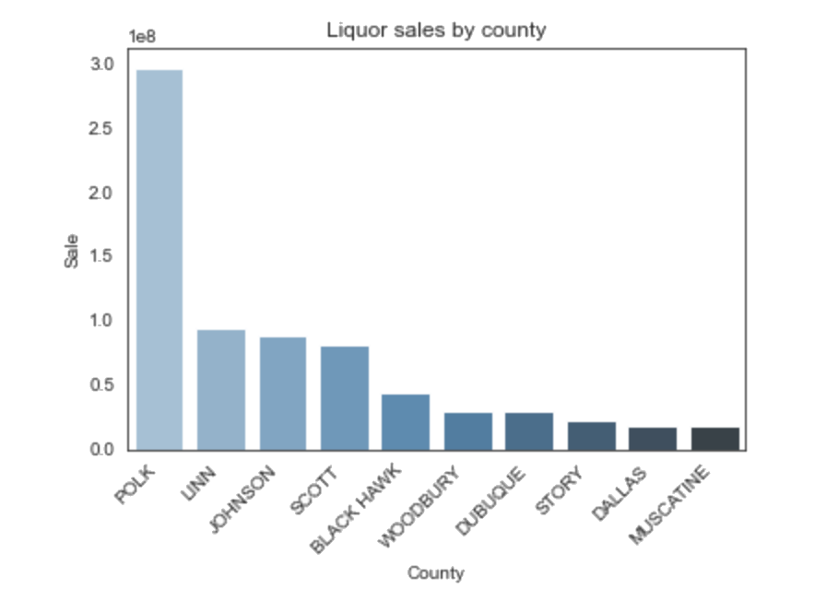
Store Sales Sales recorded by stores over the years
HyVee stores in Polk county has registered the highest sales since 2012

Slide 18
Store Sales Sales recorded by stores over the years
Liquor sales peak during Oct-Dec period which coincides with the holiday season

Slide 19
Store Sales Sales recorded by stores over the years
Sales have increased in Polk county since 2019-2020 which can be explained by the opening of new stores during this period

Slide 20
Store Sales Sales recorded by stores over the years
HyVee stores across the state have been clocking average sales of around $90k - 100k

Slide 21
Store Sales Sales recorded by stores over the years
Food & Drugstores had the highest average sales, fewer stores of this type is the most likely reason
Average sales decreasing for General Stores. Too many stores sharing the pie?

Slide 22
Store Vendors Insights into HyVee’s vendors
Top three vendors account for almost 50% of the total transactional volume

Slide 23
Store Vendors Insights into HyVee’s vendors
Transaction volume has dipped for Diageo/Jim Beam over the years whereas there is significant increase in business for Sazerac Inc. possibly indicating the increase in popularity of their brands, especially in the whiskey segment
Notes:
“Jim Murray’s Whiskey Bible 2021” lists two whiskeys produced by the Sazerac Company, Stagg Jr. (128.4 proof) and Paul John Mithuna, as the second and third finest whiskeys in the world, respectively.
In total, nine whiskeys from Sazerac received top honors in their category.
These awards follow a momentous win last year in which three whiskeys from Sazerac were named the top three whiskeys in the world in “Jim Murray’s Whiskey Bible 2020,” the first time any one company has accomplished this feat.

Slide 24
Store Inventory Most popular liquor products in stores
Vodka and whiskey by far the most popular types of spirits consumed

Slide 25
Store Inventory Most popular liquor products in stores
Consumer choices have increased in segments like vodka and whiskey with their increasing popularity

Slide 26
03
Store Segmentation
Categorize to identify high-value stores

Slide 27
Store Segmentation Determine the most valuable stores
Recency, Frequency, and Monetary Value (RFM) was used to segment stores into three categories (low, mid, high value)
The most valuable store is Hy-Vee Food Store / Urbandale located at Douglas, Polk county

Slide 28
04
Market Basket Analysis
Market Basket Analysis to identify shopping patterns

Slide 29
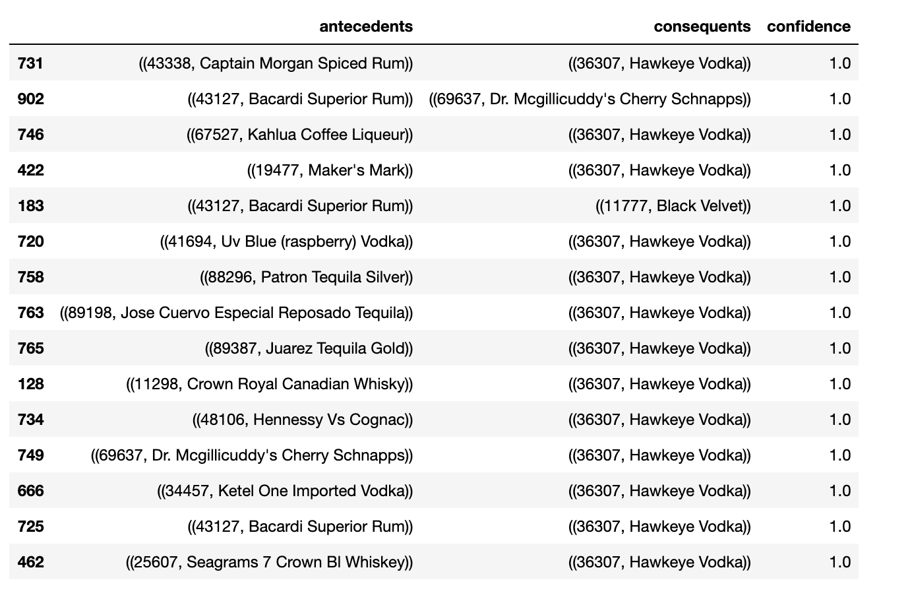
Market Basket Analysis What items are bought together in the most popular store?
MBA was limited to the 150 most popular items in the HyVee Douglas store
Hawkeye vodka, a favorite among shoppers (priced at $14.99 for 1.75 liters). Top-selling vodka and #3 best selling liquor brand in Iowa

Slide 30
05
Sales Forecast
Time series analysis and sales forecast

Slide 31
Trend Extraction Sales trend in HyVee Des Moines, Douglas over the years
Initial impression is that of high variability in sales over the years
Sales plummeted at the start of the pandemic in 2020 but have recovered to some extent since then

Slide 32
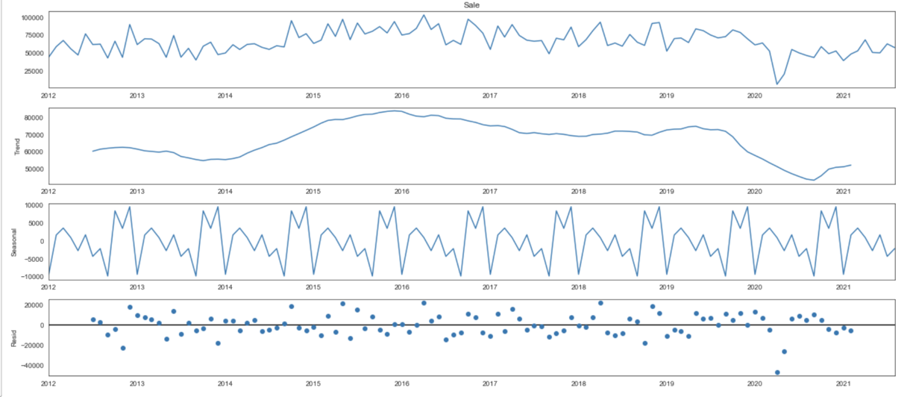
Trend Extraction Sales trend in HyVee Des Moines, Douglas over the years
Sales have been fairly robust since 2014 before the crash at the start of the pandemic, increase in residuals during this period
Seasonal trend clearly show a periodicity of 12 months which explains the variability

Slide 33
ARIMA model Diagnostics from the model results
Above graphs seem to suggest that the model fits the data well

Slide 34
ARIMA model Validating the model prediction
Comparing observed values from Aug ‘20 – Aug ‘21 with those predicted by the model during the same period
MSE = 104229781.95
RMSE = 10209.3

Slide 35
ARIMA model Sales forecast for the store
Sales forecasted to remain stable during the next 2 years with average monthly sales of around $60000

Slide 36
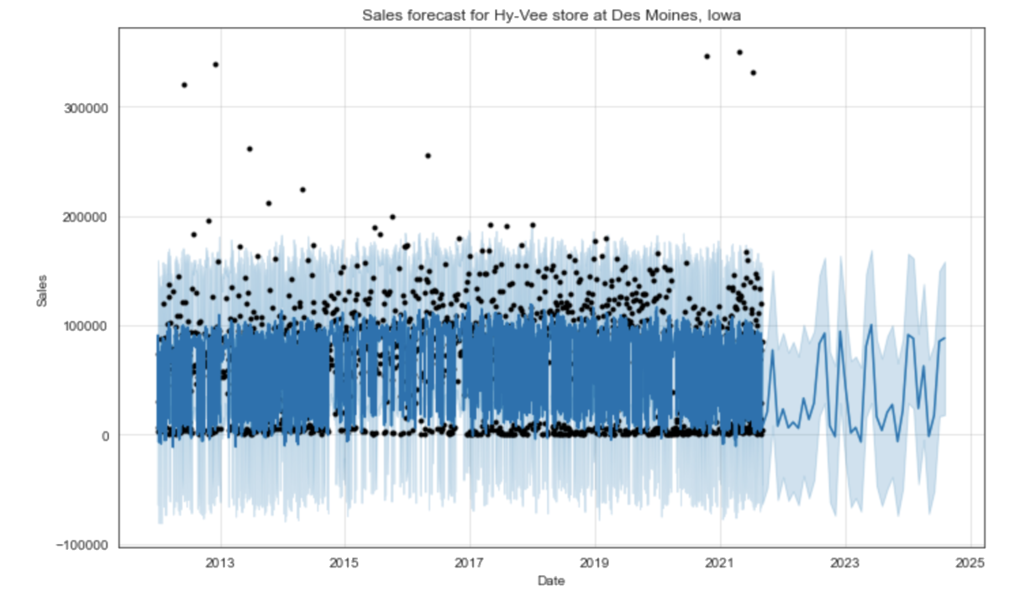
Prophet model Sales forecast for the store using prophet package
Sales forecast produced by the prophet model and the one using ARIMA are remarkably similar

Slide 37
Prophet model Sales forecast for all HyVee stores in Iowa
Overall forecast for HyVee stores indicate an upward trend in the next few years with similar seasonal variation as observed in the past years

Slide 38
06
Conclusion
Closing thoughts and the future for HyVee stores

Slide 39

Final Thoughts What can we infer from our analysis?
Indication of increased competition in areas with high density of stores resulting in lower operational lifecycle; advisable to revisit aggressive expansion strategy in areas like Polk county
Focus of expansion on General category stores impacting their sales, diversified strategy may be helpful
Will be interesting to study the factors that drive sales in October, higher than the holiday season in December
Further analysis required to understand what makes Hy-Vee Food Store at Douglas outperform other stores
Exploring other ML models to compliment the stats models we have seen in this analysis may be worthwhile

Slide 40
Thanks
Do you have any question?
Aniruddha Dhar
anirudh14.dhar@gmail.com
+91 669 240 9633

